Slide 1
Nonlinear Dynamical Systems Workshop
Thursday Morning

Slide 2
Overview (8:30)
Questions?
So, where are we?
Phases and Attractors
Self-organization
RQA
Markov
Catastrophes
Using Catastrophe Flags
Theorizing with Catastrophe
Changepoints in time series
Early Warning Signals

Slide 3
Assumptions
Assumptions carry with them affordances and constraints

Slide 4
Phases and Attractors
Manifold: The surface on which something moves
State space
Phase: The behavior (generically, not psychologically)
A phase is a trajectory “trapped” in an Attractor
One manifold may have many attractors
Trajectory: Path in state space; takes place along a manifold
Many possible trajectories on a manifold, depending upon the initial conditions
Parameter: “External” (to the state or subject) variables that determine the manifold shape
E.g. Developmental (“epigenetic landscape”; Muchisky, 1996), externals, covariates

Slide 5
State Space
Axes are important measures
Time is implicit in the trajectory
New perspective, new insights
See trajectories on an invisible manifold
Strange attractors
Two wings may be one attractor!

Slide 6
Recurrences
Near repetitions in state space
RQA
Diagonal lines
Vertical lines
Patterns in the history
Time scales

Slide 7
Markov
Dynamics?
Probabilities of transitions
Not patterns (many patterns possible from one matrix)
Not history (many histories possible from one matrix)

Slide 8
Self-organization
No external plan
Possibly external constraints!
Endogenous / exogenous
Self-organizing systems are far from equilibrium
FFE admits to all sorts of nonlinearieties, phase changes (coming up), metastability, etc.
Hence, the need for the methods this week
Metrics
Burstiness
Power laws

Slide 9
Affordances of Strange Attractors
Parameter Domains
Determine types of behaviors possible
Green & Ricca (in preparation), Littleton et al. (in preparation)
Recover manifold from data
Formal theory approach in its infancy (Cui et al., 2020)
Catastrophe theory!
Coupled trajectories
Give rise to observed states
Kelso
Coupled chaotic systems

Slide 10
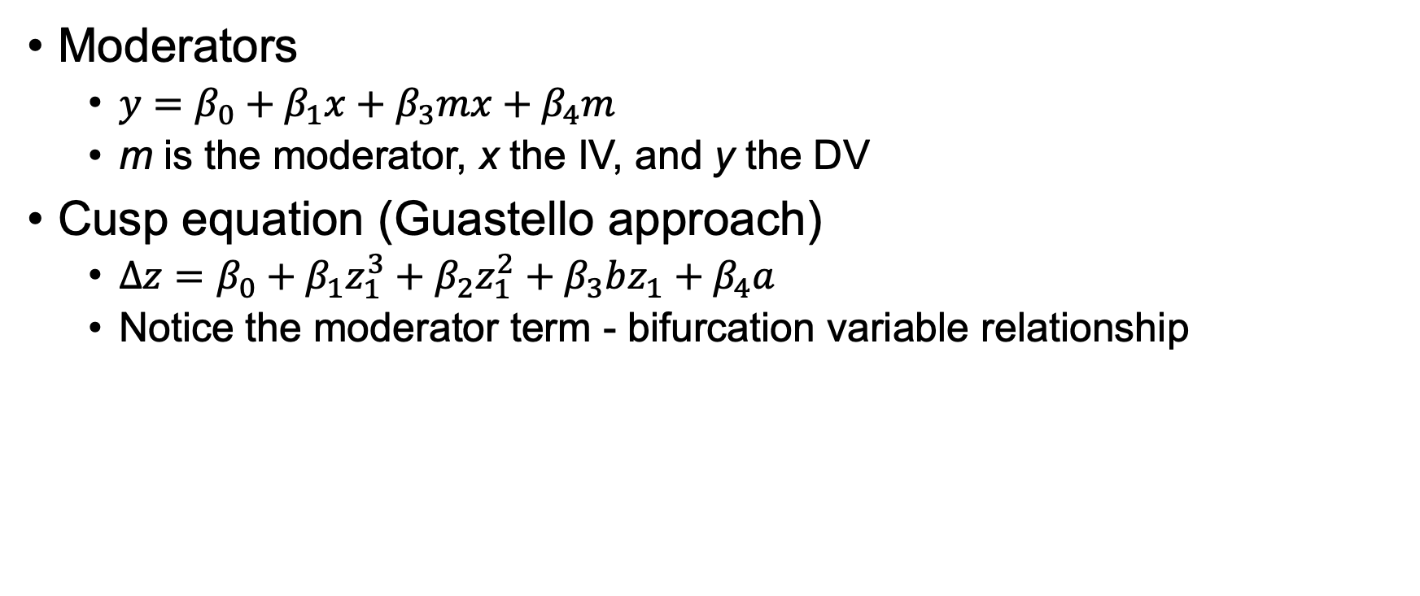
Catastrophe Equation
Moderators
$y=β_{0}+β_{1}x+β_{3}mx+β_{4}m$
m is the moderator, x the IV, and y the DV
Cusp equation (Guastello approach)
$Δz=β_{0}+β_{1}z_{1}^{3}+β_{2}z_{1}^{2}+β_{3}bz_{1}+β_{4}a$
Notice the moderator term - bifurcation variable relationship

Slide 11
Caveat: Methodological Borrowing
Is this a good metaphor for living sciences?
Mathematics relies on a lot of assumptions about continuity
Mathematics relies on the existence of a potential function
Potentials are only good under some strict assumptions
Morin: Complexity vs. laws
Pragmatist view
It provides insight
Caveat: Cumulative science

Slide 12
Catastrophes

Slide 13
devtools to the rescue!
Nothing on the Internet is ever truly gone:
Especially when CRAN stands for: Comprehensive R Archive Network
devtools::install_github(“cran/cusp”)
Install and library

Slide 14
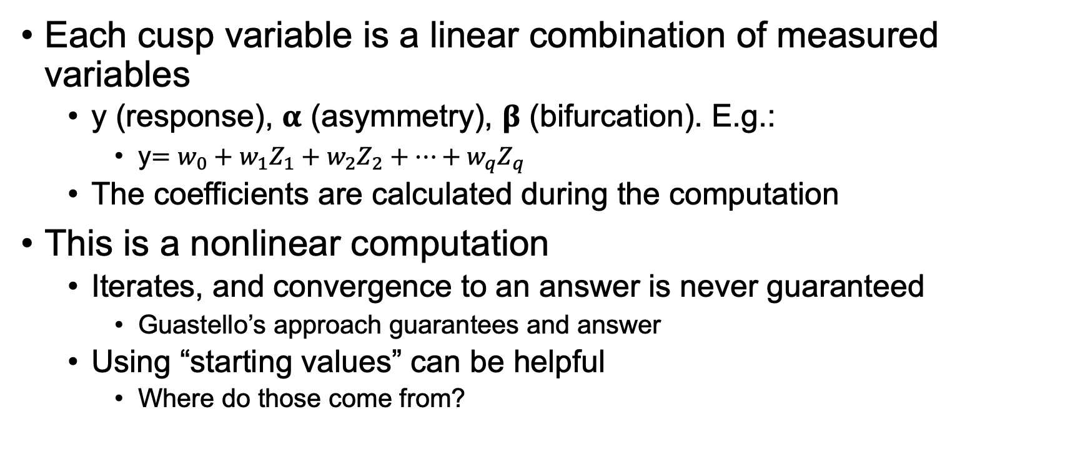
Some details
Each cusp variable is a linear combination of measured variables
y (response), 𝛂 (asymmetry), 𝛃 (bifurcation). E.g.:
y$=w_{0}+w_{1}Z_{1}+w_{2}Z_{2}+…+w_{q}Z_{q}$
The coefficients are calculated during the computation
This is a nonlinear computation
Iterates, and convergence to an answer is never guaranteed
Guastello’s approach guarantees and answer
Using “starting values” can be helpful
Where do those come from?

Slide 15

Simulated data
Create a cusp (Oliva et al., 1987) – NDSCusp4
$$α_{i}=X_{1}−0.969X_{2}−0.201X_{3}$$
$$β_{i}=0.44Y_{1}+0.08Y_{2}+0.67Y_{3}+0.19Y_{4}$$
$$y_{i}=−0.52Z_{1}−1.60Z_{2}$$

Slide 16
Fit Oliva data
data(oliva)
set.seed(121)
fit <- cusp(y ~ z1 + z2 - 1,
alpha ~ x1 + x2 + x3 - 1,
beta ~ y1 + y2 + y3 + y4 - 1,
data = oliva,
start = rnorm(9)) # If you have them!
summary(fit)
cusp3d(fit, B=5.25, n.surf=50, theta=150)
plot(fit)

Slide 17
Cusp Example
NDSCusp1
van der Maas et al. (2003)
Data:
Outcome: Attitude toward what government should do
Asymmetry: Political orientation
Bifurcation: Political involvement (+ political orientation)
Look at it with and without “starters”
Their approach, although I respect van der Mass a lot, is a bit iffy…

Slide 18
Break (9:45)
We’ll start back up at 10:00

Slide 19
Cusp CYO
Sguotti et al. (2019)
NDSCusp2
Response: Cod SB
Asymmetry: Fishing mortality (FM)
Bifurcation: Surface temperature (SST)
Benight et al. (2020)
NDSCusp3
Response: Change in distress, T₂ to T₃
Asymmetry: disaster exposure, gender, and time since the wildfire; PDEQ
Bifurcation: CSE (T₂)

Slide 20
Theorizing with Catastrophe Flags
Bi- or multi-modality
Low probability of being between states for the IV that are multi-stable
Inconsistent results from previous studies
One IV as a moderator of another
Moderator -> bifurcation, moderated -> asymmetry
Sudden jumps between states with small IV changes
Location of jumps form the edge of the bifurcation set
Each state can be reached by either increasing or decreasing IV
Direction of jump depends on direction of variable change
Hysteresis (location of jump)

Slide 21
Example of Theorizing
From Chen et al. (2014)
Outcome: Geriatric grip strength (normal or impaired)
Grip strength predicts frailty
Continuous scale, but strongly bimodal
Interleukin-6 (IL-6)
Inflammation marker
Asymmetry factor
Executive Functioning (EF)
Muscle strength depends on brain functioning
Bifurcation factor: brain can overcome inflammation

Slide 22
Catastrophe Theorizing: Variables
Asymmetry parameter vs. Bifurcation parameter
Sometimes, theory indicates which variable is which
Moderator (bifurcation) vs. moderated (asymmetry)
Sometimes, see which variable behaves like an asymmetry
Linear modeling
Flags
Hysteresis (dents/tendrils, holes) in asymmetry
Divergence (notches) but no hysteresis in bifurcation

Slide 23
Changepoints and EWS

Slide 24
Changepoints and warnings
Identify changepoints
If you can identify the changepoints
Usually done “offline”
Can’t always a priori identify the changepoints
Use the EWS to identify potential changepoints
Do this “online”

Slide 25
Classical Changepoints (10:45)
Is there a change in a data stream’s mean value?
changepoint::cpt.mean(…)
Is there a change in a data stream’s slope?
Use package:cpop
Get standard error (se) of slope of first part of fit
changepoints(cpop(t, y, se))
Notes:
Some spurious results possible if one doesn’t take care. See https://rpubs.com/richkt/269908 for more info.

Slide 26
Classical Changepoints (10:50)
Aswan Dam (1871-1970)
cpt.mean(pull(read_csv("http://bit.ly/NDSAswan.csv")),
penalty = “SIC”,
method = “AMOC”, # PELT for multiple pts
class = FALSE)
When was the Aswan dam on the Nile completed? (Look it up!)

Slide 27
Second Changepoint example (10:55)
NDSChange1
A contrived dataset created with changes at time points 20, 50, and 170
cpt.mean(pull(read_csv("http://bit.ly/NDSChange1.csv")),
penalty = “SIC”,
method = “PELT”, # PELT for multiple pts
class = FALSE)

Slide 28
Slope Changepoint example (11:00)
Synthetic data used
Plot the data
Fit the beginning of the data
Find standard error of the slope
changepoint(
cpop(read_csv("http://bit.ly/NDSSlopeChange.csv")$t,
read_csv("http://bit.ly/NDSSlopeChange.csv")$y,
sd = 0.01) # I did a fit to find this value

Slide 29
Early Warning Signals

Slide 30
Early Warning Signals (EWS)
Two basins, revisited
Look what happens as the basin gets shallower or the ball has more “free energy”
Wider range of oscillation
Endogenous dynamics only
But: changes in parameters can sometimes be detected as well, as parameter changes can change the manifold topology (What?!)

Slide 31
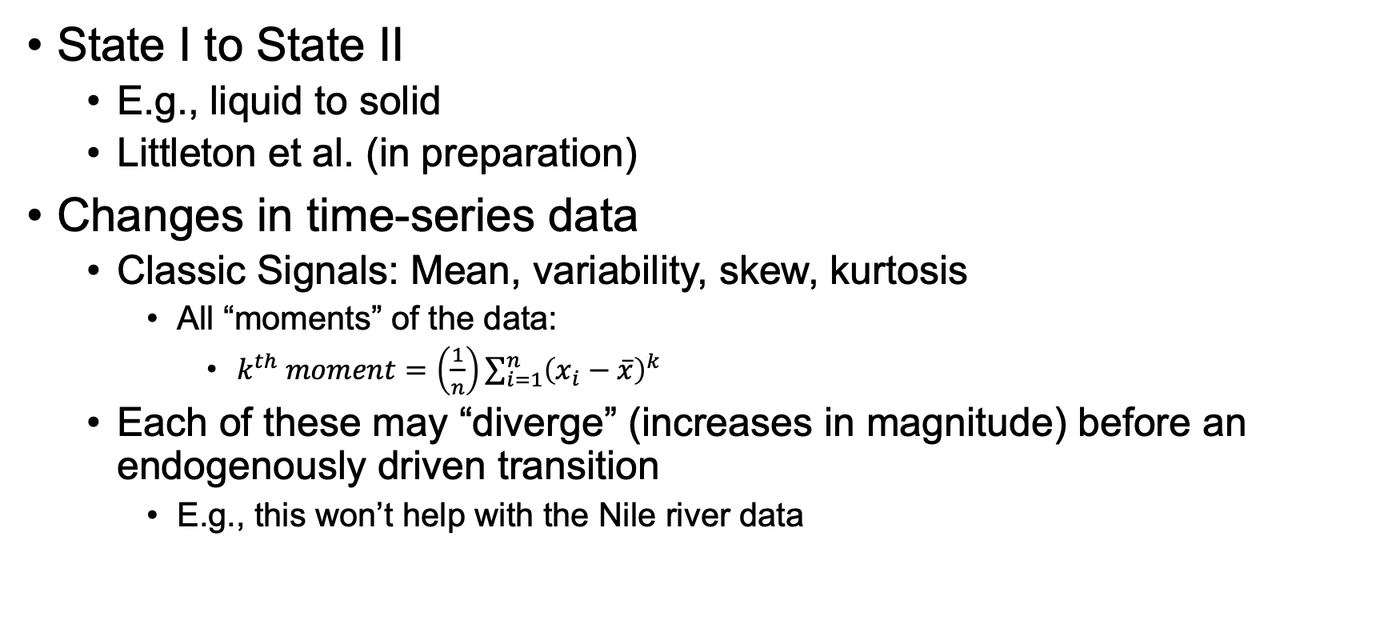
Early Warning Signals (EWS)
State I to State II
E.g., liquid to solid
Littleton et al. (in preparation)
Changes in time-series data
Classic Signals: Mean, variability, skew, kurtosis
All “moments” of the data:
$k^{th} moment=\left(\frac{1}{n}\right)\sum_{i=1}^{n}{{\left(x_{i}−\overline{x}\right)}^{k}}$
Each of these may “diverge” (increases in magnitude) before an endogenously driven transition
E.g., this won’t help with the Nile river data

Slide 32
Early Warning Signals (EWS)
Critical slowing down: response to perturbations
Uh…hard to do in most systems, unless a natural experiment occurs
Critical slowing down: covariance of measures
Correlation across variables increases (at least an eigenvalue covariance matrix does)
Good for EMA and other panel data
Autocorrelation (“AR(1) coefficient”) increases
Flickering
Works only if there isn’t hysteresis
Unsteadiness in response or performance
Divergence of windowed entropy
Especially useful for categorical data series

Slide 33
Warning: Phase Transitions
Piaget and cognitive schema
Schema is a dynamic(!) equilibrium between assimilation and accommodation
“Adiabatic” in physics sense
New information can produce dis-equilibration
Re-equilibration to new schema, possibly unconnected to previous schema
Recall the mosquitoes
Nota bene: State I – transitional phase – State II
Sometimes, the EWS is itself a phase that comes without warning
Time scales

Slide 34
Lunch (11:30)
We’ll start back up at 1:30

